Slide 1

Database Management Systems
Chapter 1
Database Management Systems 3ed, R. Ramakrishnan and J. Gefrke

Slide 2

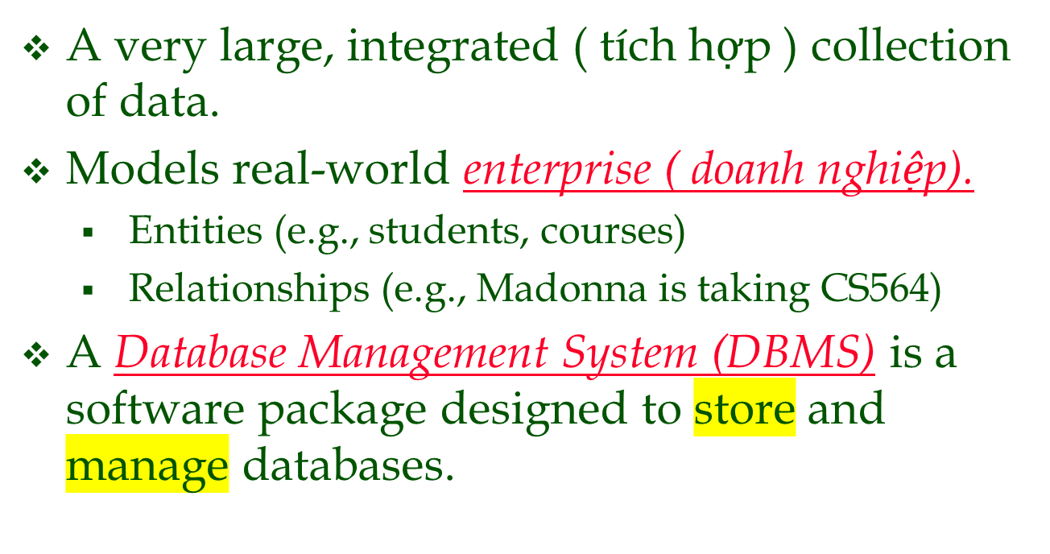
What Is a DBMS?

Slide 3
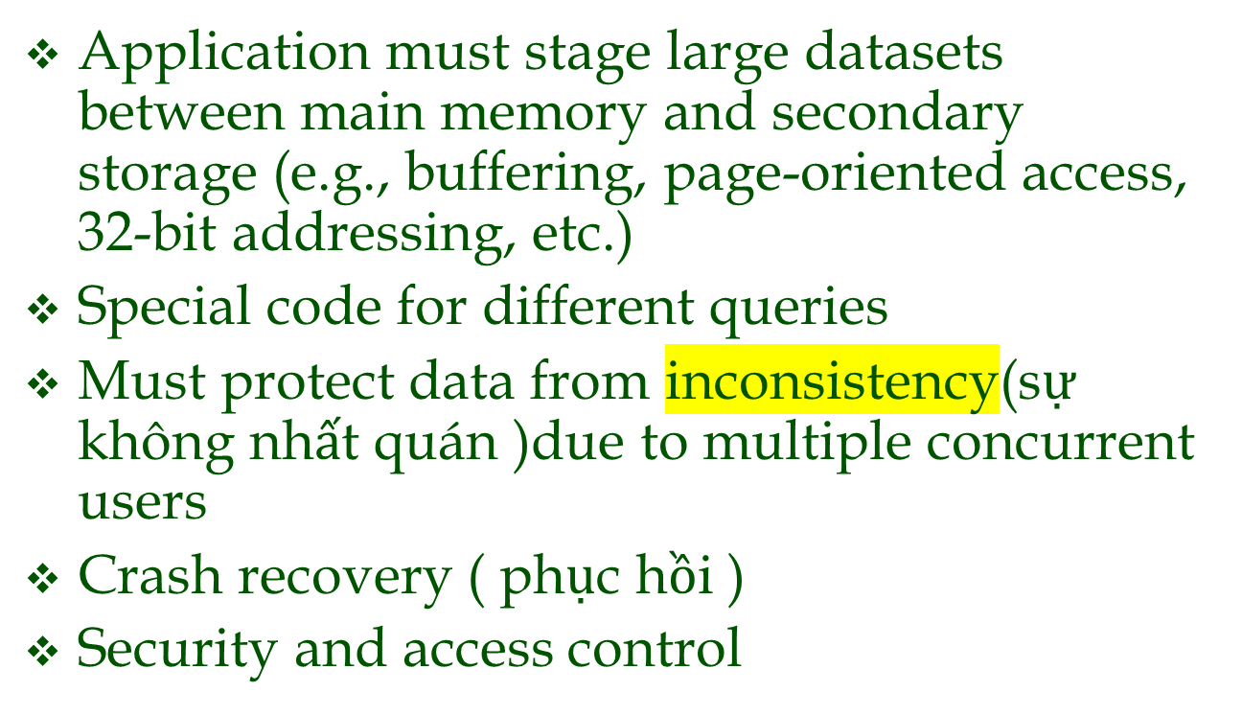
Files vs. DBMS

Slide 4

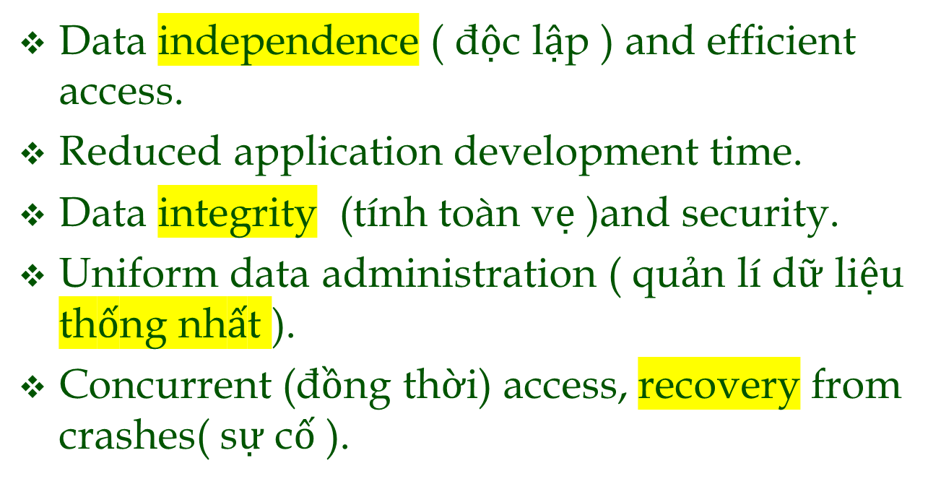
Why Use a DBMS?
Notes:
3

Slide 5
Why Study Databases??
?
Shift from computation to information (Chuyển đổi từ tính toán sang thông tin trong lĩnh vực cơ sở dữ liệu)
  at the “low end”: scramble to webspace (a mess!)
  at the “high end”: scientific applications
Datasets increasing in diversity and volume.
  Digital libraries, interactive video, Human Genome project, EOS project
  ... need for DBMS exploding
DBMS encompasses most of CS
  OS, languages, theory, AI, multimedia, logic

Slide 6
Data Models
A data model is a collection of concepts for describing data.
A schema is a description of a particular collection of data, using the a given data model.
The relational model of data (mô hình dư liệu quan hệ )is the most widely used model today.
  Main concept: relation, basically a table with rows and columns.
  Every relation has a schema, which describes the columns, or fields.
Notes:
5

Slide 7
Levels of Abstraction
Many views, single conceptual (logical) schema and physical schema.
  Views describe how users see the data.
  Conceptual schema defines logical structure
  Physical schema describes the files and indexes used.
View 1
View 2
View 3
Conceptual (khái niệm)Schema
Physical Schema
Schemas are defined using DDL; data is modified/queried using DML.
Notes:
6

Slide 8
Example: University Database
Conceptual schema:
  Students(sid: string, name: string, login: string,
  age: integer, gpa:real)
  Courses(cid: string, cname:string, credits:integer)
  Enrolled(sid:string, cid:string, grade:string)
Physical schema:
  Relations stored as unordered files.
  Index on first column of Students.
External Schema (View):
  Course_info(cid:string,enrollment:integer)
Notes:
7

Slide 9
Data Independence *
Applications insulated from how data is structured and stored.
Logical data independence: Protection from changes in logical structure of data.
Physical data independence: Protection from changes in physical structure of data.
One of the most important benefits of using a DBMS!

Slide 10
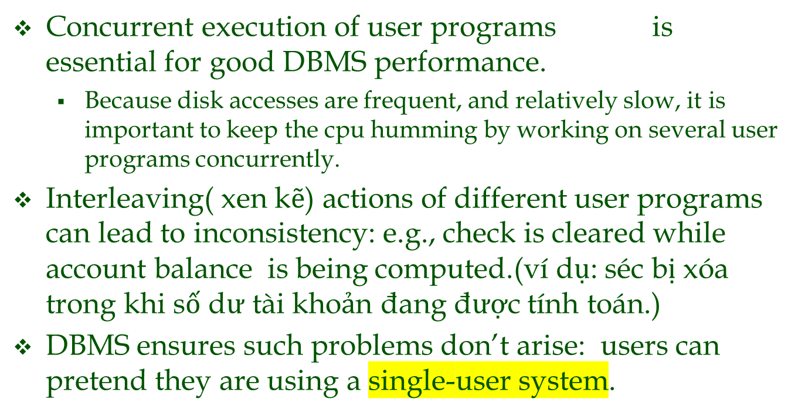
Concurrency Control (Độc lập dữ liệu – kiểm soát đồng thời *)

Slide 11
Transaction: An Execution of a DB Program
Key concept is transaction, which is an atomic sequence of database actions (reads/writes).
Each transaction, executed completely, must leave the DB in a consistent state ( trạng thái nhất quán ) if DB is consistent when the transaction begins.
  Users can specify some simple integrity constraints ( ràng buộc toàn vẹn ) on the data, and the DBMS will enforce these constraints.
  Beyond this, the DBMS does not really understand the semantics (ngữ nghĩa )of the data. (e.g., it does not understand how the interest on a bank account is computed).
  Thus, ensuring that a transaction (run alone) preserves ( bảo quản ) consistency is ultimately the user’s responsibility!

Slide 12
Scheduling Concurrent Transactions
DBMS ensures that execution of {T1, ... , Tn} is equivalent to some serial (nối tiếp )execution T1’ ... Tn’.
  Before reading/writing an object, a transaction requests a lock on the object, and waits till the DBMS gives it the lock. All locks are released at the end of the transaction. (Strict 2PL locking protocol.)
  Idea: If an action of Ti (say, writing X) affects Tj (which perhaps reads X), one of them, say Ti, will obtain the lock on X first and Tj is forced to wait until Ti completes; this effectively orders the transactions.
  What if Tj already has a lock on Y and Ti later requests a lock on Y? (Deadlock!) Ti or Tj is aborted and restarted!

Slide 13
Ensuring Atomicity
DBMS ensures atomicity (all-or-nothing property) even if system crashes in the middle of a Xact.
Idea: Keep a log (history) of all actions carried out by the DBMS while executing a set of Xacts:
  Before a change is made to the database, the corresponding(tương ứng) log entry is forced ( bị ép ) to a safe. (WAL protocol; OS support for this is often inadequate .( không thoả đáng)
  After a crash, the effects of partially executed transactions are undone using the log. (Thanks to WAL, if log entry wasn’t saved before the crash, corresponding change was not applied to database!)

Slide 14

The Log
The following actions are recorded in the log:
  Ti writes an object: The old value and the new value.
    Log record must go to disk before the changed page!
  Ti commits/aborts: A log record indicating this action.
Log records chained together by Xact id, so it’s easy to undo a specific Xact (e.g., to resolve a deadlock).
Log is often duplexed and archived ( lưu trữ ) on “stable” storage.
All log related activities (and in fact, all CC related activities such as lock/unlock, dealing with deadlocks etc.) are handled transparently by the DBMS.
Notes:
20

Slide 15

Databases make these folks happy ...
End users and DBMS vendors ( nhà cung cấp )
DB application programmers
  E.g., smart webmasters
Database administrator (DBA)
  Designs logical /physical schemas
  Handles security and authorization
  Data availability, crash recovery
  Database tuning as needs evolve (Điều chỉnh cơ sở dữ liệu khi nhu cầu phát triển)
Must understand how a DBMS works!
Notes:
21

Slide 16
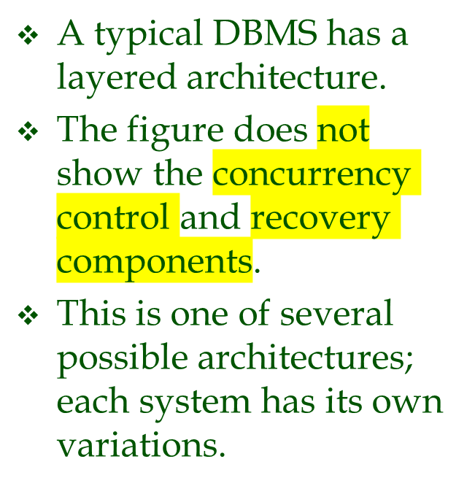
Structure of a DBMS
These layers
must consider
concurrency
control and
recovery
Query Optimization
and Execution
Relational Operators
Files(tệp) and Access Methods
Buffer Management
Disk Space Management
DB
Notes:
22

Slide 17

Summary
DBMS used to maintain, query large datasets.
Benefits include recovery from system crashes, concurrent access, quick application development, data integrity and security.
Levels of abstraction give data independence( sự độc lập ).
A DBMS typically has a layered architecture.
DBAs hold responsible jobs and are well-paid! ☺
DBMS R&D is one of the broadest, most exciting areas in CS.

